Slide 1
Water/Ice
By Elizabeth K Miller

Slide 2
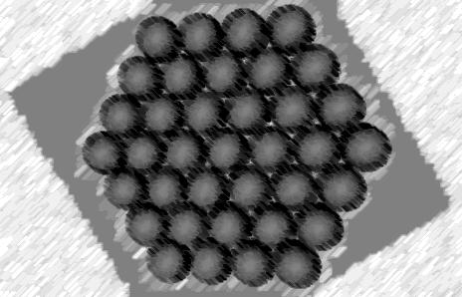
Solid
Solids are tightly knit. The molecules are formed closely together.

Slide 3
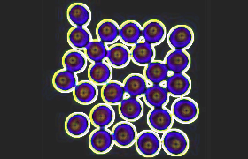
Liquid
Liquids are less compact. The molecules are more spread out and more rapidly moving.

Slide 4
Movement of Sound
Solid
Liquid
Sound moves more readily through them (17 times faster)
We don’t always hear the sound because of lack of oxygen ( like in a vacuum)
Sound move slower but not as slow as a gas
We can hear sound but may not be as clear as in a gas.

Slide 5
New Science
Mr. Emoto
Claims that water can hold onto sound vibrations and when frozen they produce a unique crystal

Slide 6
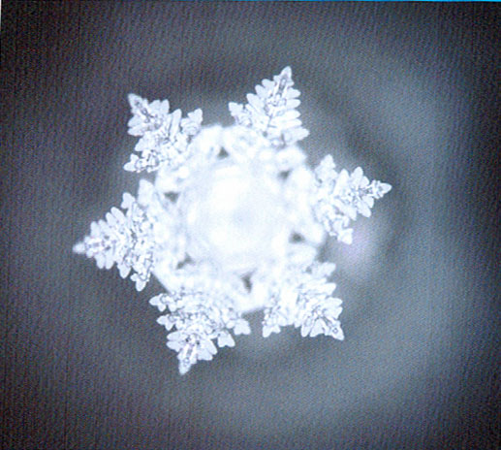
Mr. Emoto’s Work
This is a picture of "The Modau ". It is believed to rid irritability by the use of the lymphatic system. When a person listens to “The Modau” they feel calmer and according to Emoto water can feel this too and the pretty crystal shows that.

Slide 7
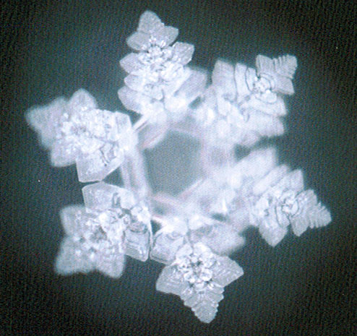
This is the "The Blue Danube". Emoto believed this would affect your central nervous system by restoring it. It is thought by Emoto this song would relieve stress and fatigue. The crystal is supposed to emulate that.

Slide 8
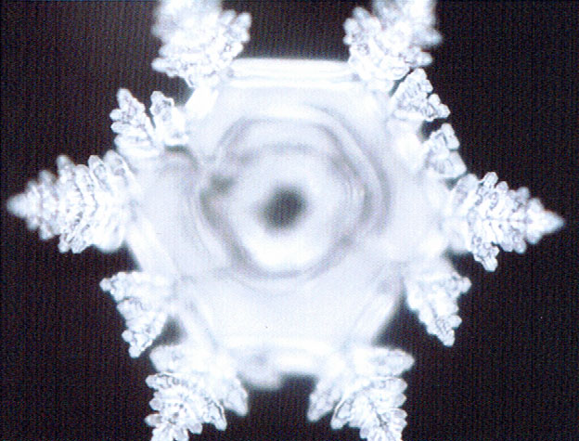
This is the Prelude to Act One From the Opera. Emoto believed that his resonated with self-love. The music could physically relieve joint pain so Emoto says.

Slide 9
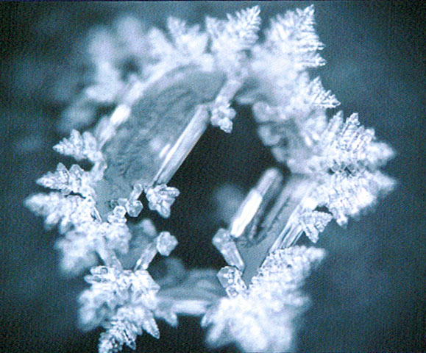
This is "The Trevi Fountain at Noon" From The Fountains of Rome. This is thought to bring good fortune. The water is supposed to show that the water was forming to the emotion of fortune. The water itself would be a buffer to illness.

Slide 10
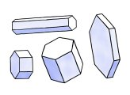
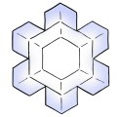
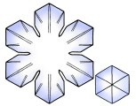


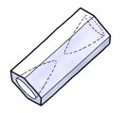

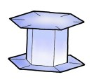
About Physics and Crystal Formations

Slide 11
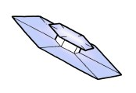

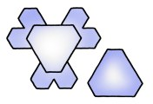



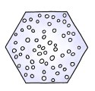

Slide 12
Why his theory doesn’t hold water
* Sound moves through solids quickly. It would not be trapped in water.
* The crystal formations are more likely caused by temperature or irregularities in the water then by sound vibrations
* He has not been able to replicate the experiment successfully even after a scientist offered him 1 million dollars if he can replicate it.
* When sound travels through an object they go through compression and rarefaction. This happens fairly quickly. (In this experiment songs were played and then after the water was frozen). Any molecules displaced would have time to go back to their original position

Slide 13
All crystals are unique. No one crystal is exposed to the same environment.

Slide 14
References
http://www.its.caltech.edu/~atomic/snowcrystals/class/class.htm
http://www.whatthebleep.com/scientists/#Emoto
http://www.its.caltech.edu/~atomic/snowcrystals/class/class.htm
http://www.reversespins.com/Water_Crystal_Healing.htm
http://library.thinkquest.org/19537/Physics4.html

